Slide 1
TEDA Algorithm
Data Stream
Pedro Henrique Meira de Andrade
Git: pedrohmeiraa
Supervisor: Prof. Dr. Ivanovitch Medeiros Dantas da Silva
Graduate Program in Electrical and Computer Engineering (PPgEEC/UFRN)

Slide 2

TEDA
TEDA (Typicality and Eccentricity Data Analytics) Algorithm was proposed by Angelov in 2014 to detect anomalies in data streams.
Typicality is the similarity of a sample to the rest of the set (based on distances between samples), while eccentricity is its opposite when indicating how different a sample is from the rest of the collected data.
Datastreams.
TEDA uses the sum of the geometric distances between the analyzed sample and the other samples in the set. The higher this value, the greater the eccentricity of the sample in relation to the others and, consequently, the lower the value of typicality.

Slide 3
Advantages x Disadvantages:
Advantages: MCUs are cheap, widespread and have low energy comsumption.
Disadvantages: Low processing power and memory constraints.
Applications: Vehicles, audio processing, industry, home appliances, etc.

Slide 4

TEDA
TEDA has advantages over traditional statistical methods for detecting anomalies:
no need for prior knowledge of the data, therefore, it is widely used for data streams and time series.
it is not necessary to know the mathematical model or the data distribution, being an important advantage for real-world problems.
It measures the typicality and eccentricity of each sample through geometric distances (Euclidean or cosine or Mahalonobis).
Computational effort is low and fast.

Slide 5
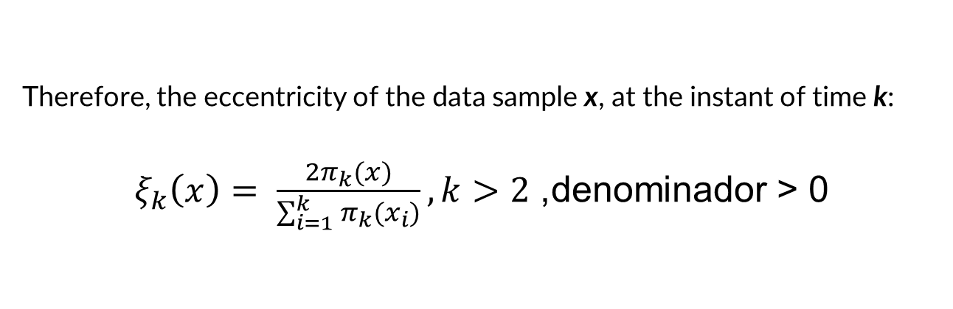
TEDA
Therefore, the eccentricity of the data sample x, at the instant of time k:
$ξ_{k}\left(x\right)= \frac{2π_{k}(x)}{\sum_{i=1}^{k}{π_{k}(x_{i})}}, k>2$, denominador > 0

Slide 6
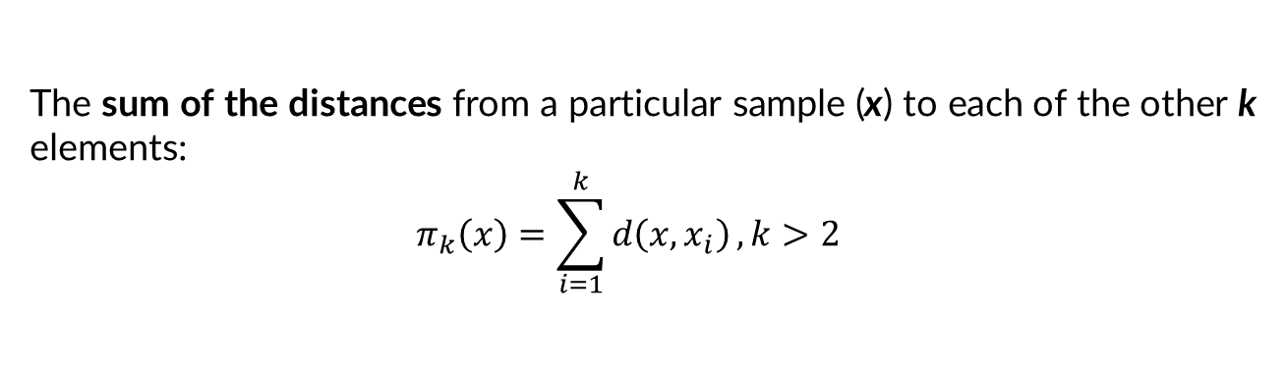
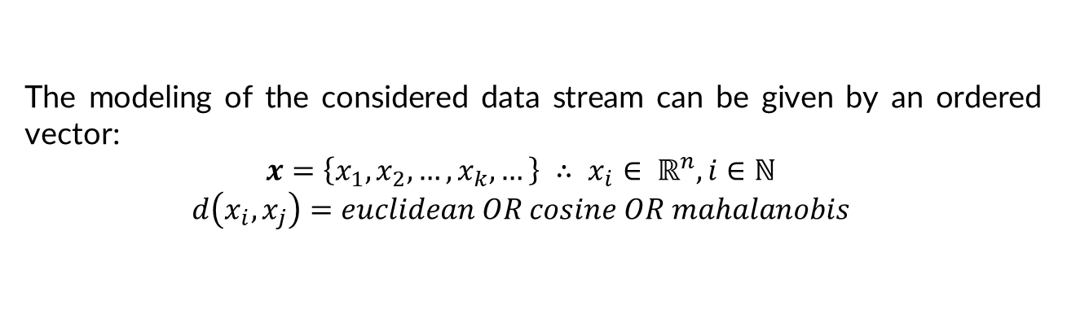
TEDA
The modeling of the considered data stream can be given by an ordered vector:
$$x=\left\{x_{1},x_{2}, …, x_{k}, …\right\} ∴ x_{i}∈ ℝ^{n}, i∈ℕ$$
$$d\left(x_{i}, x_{j}\right)=euclidean OR cosine OR mahalanobis$$
The sum of the distances from a particular sample (x) to each of the other k elements:
$$π_{k}\left(x\right)=\sum_{i=1}^{k}{d\left(x, x_{i}\right)}, k>2$$

Slide 7

Cat Jump

Slide 8
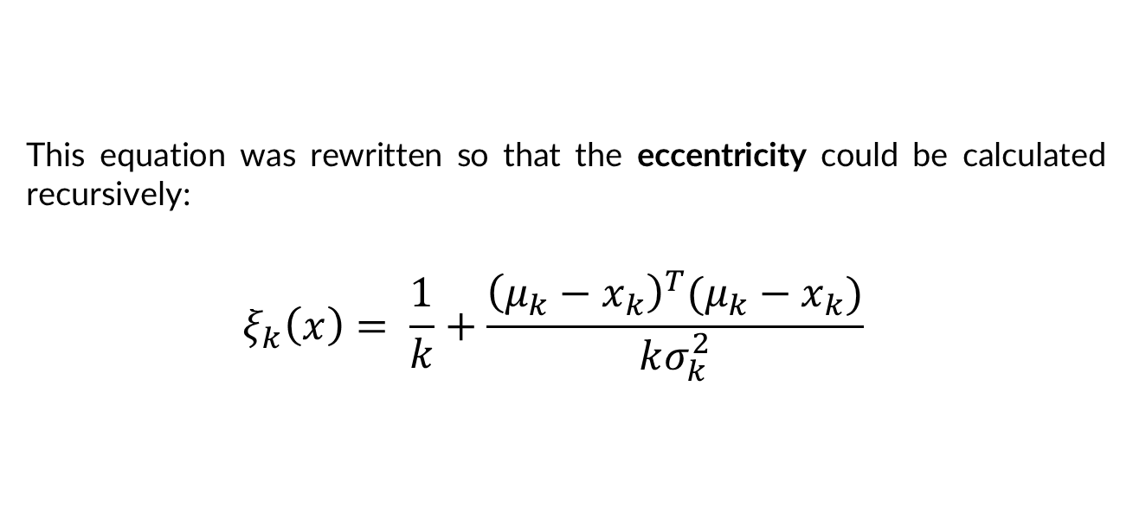
TEDA
This equation was rewritten so that the eccentricity could be calculated recursively:
$$ξ_{k}\left(x\right)= \frac{1}{k}+\frac{{\left(μ_{k}−x_{k}\right)}^{T}(μ_{k}−x_{k})}{kσ_{k}^{2}}$$
mean
mean
variance

Slide 9
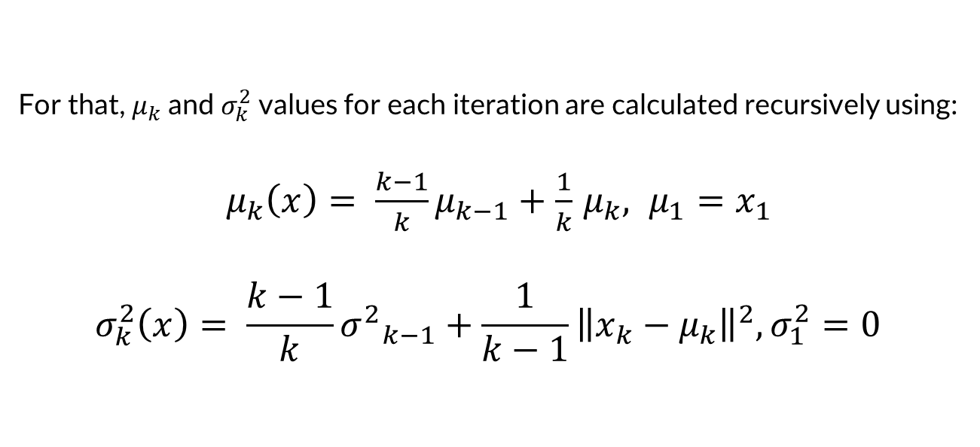
TEDA
For that, $μ_{k}$and $σ_{k}^{2}$values for each iteration are calculated recursively using:
$μ_{k}\left(x\right)= \frac{k−1}{k}μ_{k−1}+\frac{1}{k}$ $μ_{k}, μ_{1}=x_{1}$
$$σ_{k}^{2}\left(x\right)= \frac{k−1}{k}{σ^{2}}_{k−1}+\frac{1}{k−1}{\left\|x_{k}−μ_{k}\right\|}^{2}, σ_{1}^{2}=0$$

Slide 10
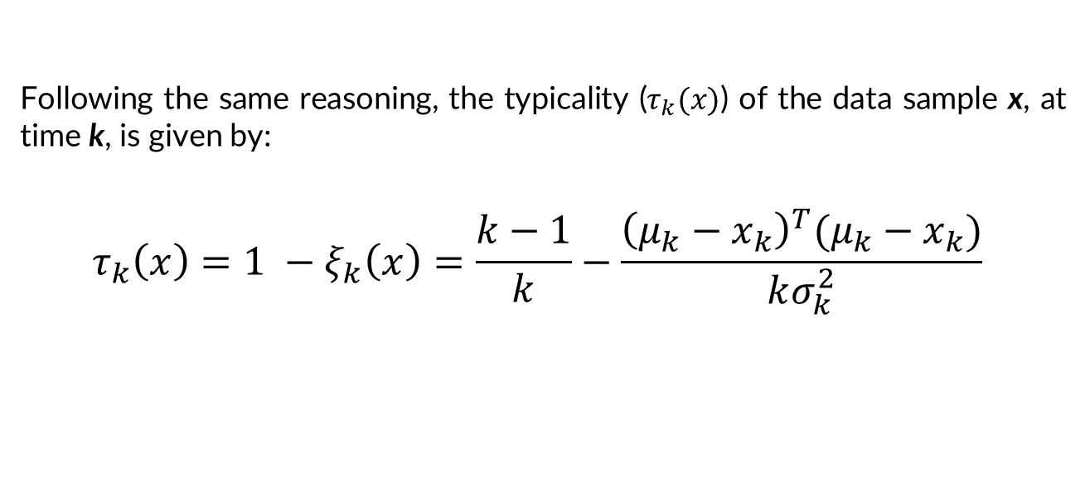
TEDA
Following the same reasoning, the typicality ($τ_{k}(x)$) of the data sample x, at time k, is given by:
$$τ_{k}\left(x\right)=1 −ξ_{k}\left(x\right)=\frac{k−1}{k}−\frac{{\left(μ_{k}−x_{k}\right)}^{T}(μ_{k}−x_{k})}{kσ_{k}^{2}}$$

Slide 11
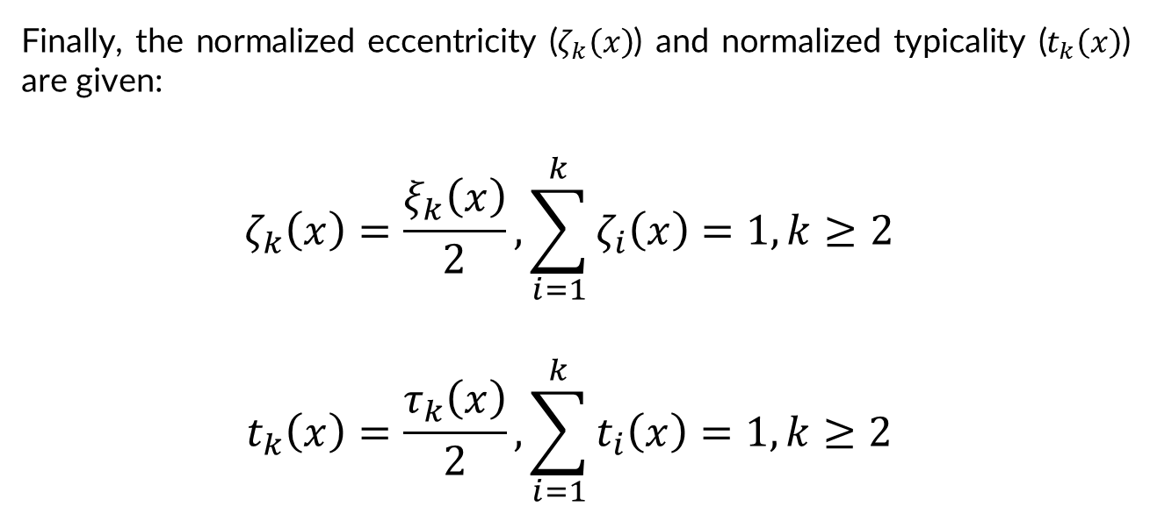
TEDA
Finally, the normalized eccentricity ($ζ_{k}\left(x\right)$) and normalized typicality ($t_{k}\left(x\right)$) are given:
$$ζ_{k}\left(x\right)=\frac{ξ_{k}\left(x\right)}{2}, \sum_{i=1}^{k}{ζ_{i}\left(x\right)=1, k≥2}$$
$$t_{k}\left(x\right)=\frac{τ_{k}\left(x\right)}{2}, \sum_{i=1}^{k}{t_{i}\left(x\right)=1, k≥2}$$

Slide 12
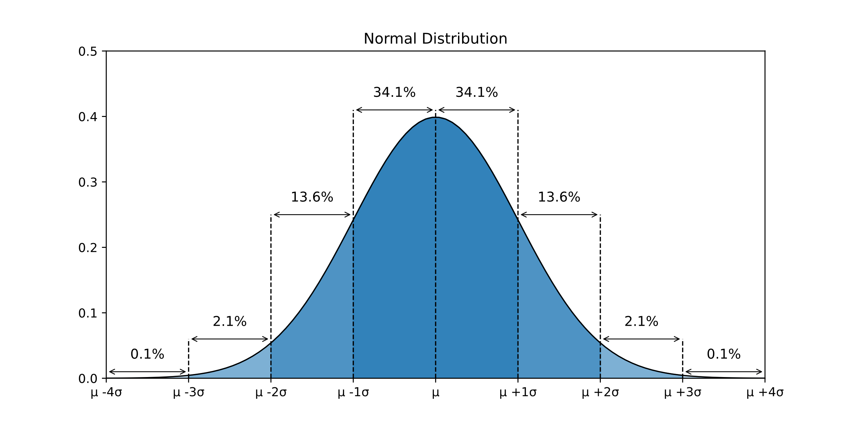

TEDA
Now, the next step: Outlier Detection!
One of the simplest and most well-known methods in the literature is to use “$mσ$” as a threshold for classification -> Gaussian distribution.

Slide 13

TEDA
But if my dataset do not have a Gaussian distribution?

Slide 14
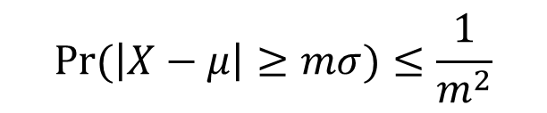
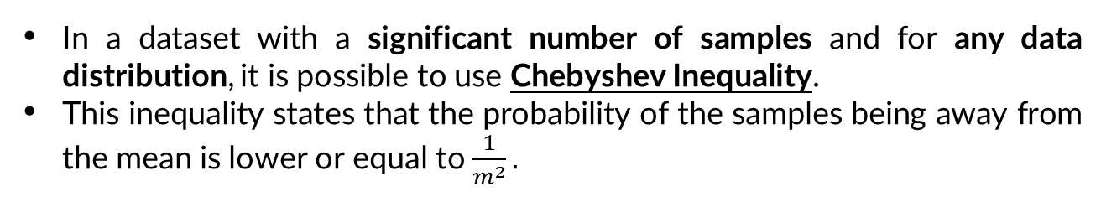
TEDA
In a dataset with a significant number of samples and for any data distribution, it is possible to use Chebyshev Inequality.
This inequality states that the probability of the samples being away from the mean is lower or equal to $\frac{1}{m^{2}}.$
$$Pr⁡(\left|X−μ\right|≥mσ)≤\frac{1}{m^{2}}$$

Slide 15
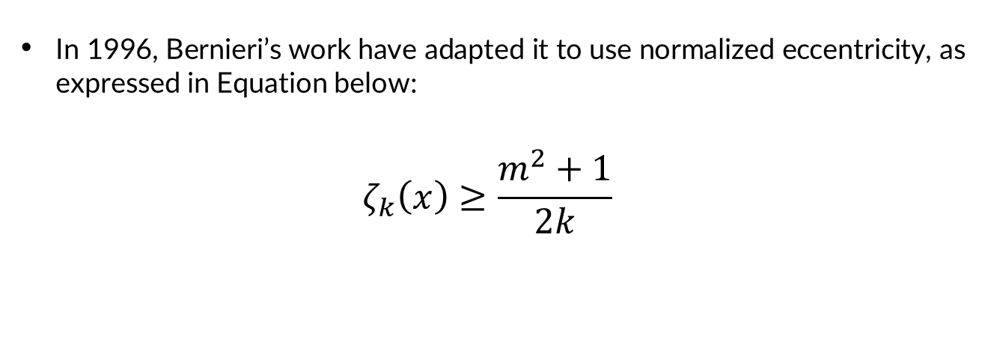
TEDA
In 1996, Bernieri’s work have adapted it to use normalized eccentricity, as expressed in Equation below:
$$ζ_{k}\left(x\right)≥\frac{m^{2}+1}{2k}$$

Slide 16
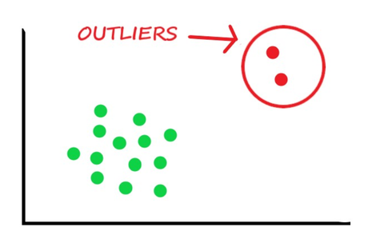
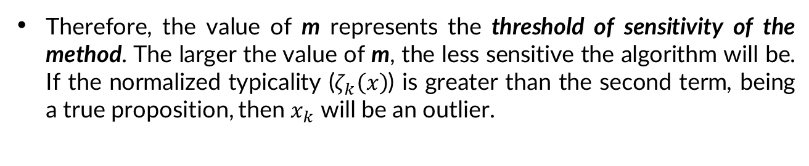
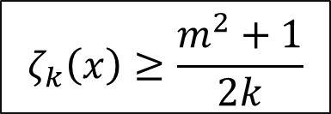
TEDA
Therefore, the value of m represents the threshold of sensitivity of the method. The larger the value of m, the less sensitive the algorithm will be. If the normalized typicality ($ζ_{k}\left(x\right)$) is greater than the second term, being a true proposition, then $x_{k}$ will be an outlier.
$$ζ_{k}\left(x\right)≥\frac{m^{2}+1}{2k}$$

Slide 17
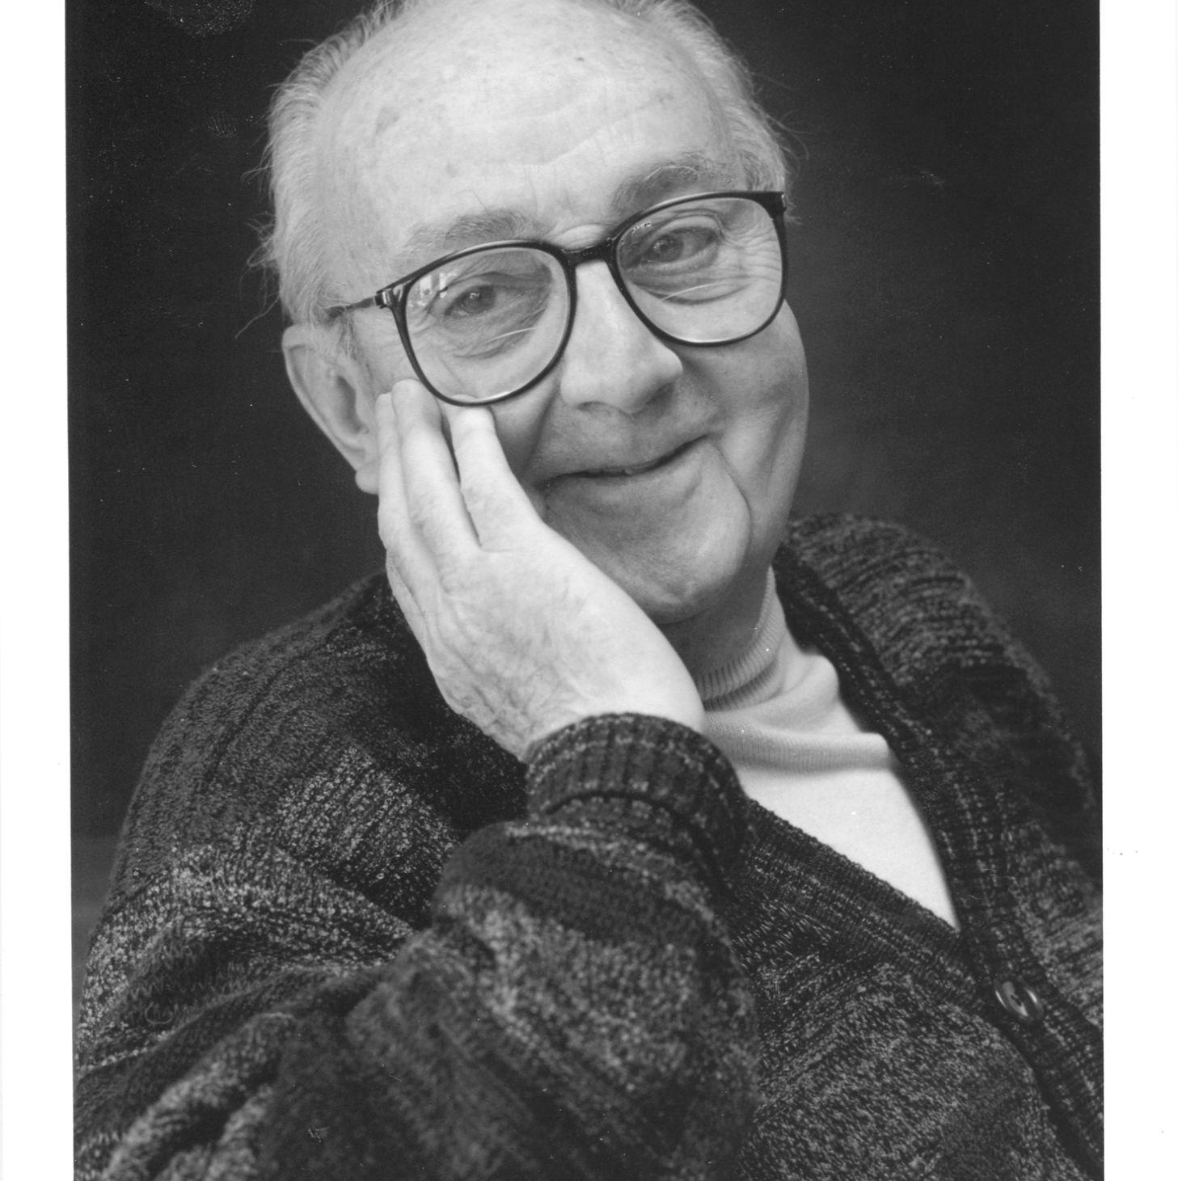
“All models are wrong, but some are useful”.
—George E. P. Box (British statistician)

Slide 18

Let’s go to

